Slide 1
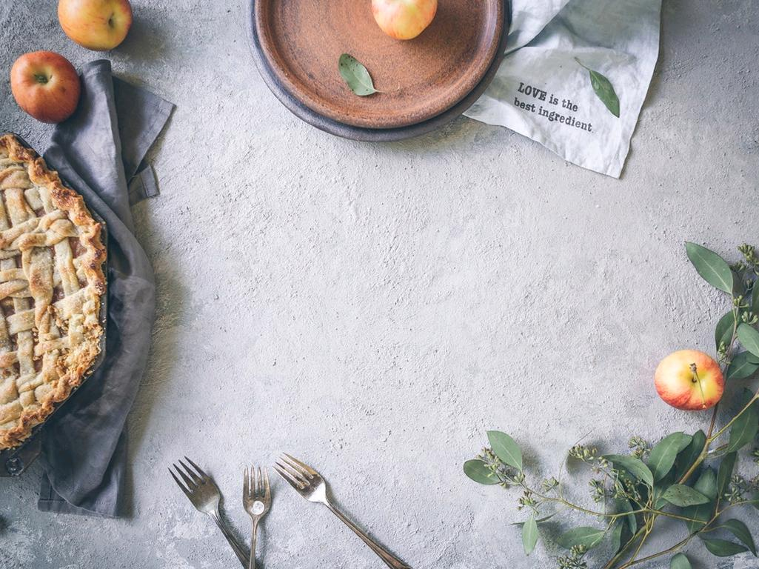
Baking Basics
cc: Brooke Lark - https://unsplash.com/@brookelark?utm_source=haikudeck&utm_medium=referral&utm_campaign=api-credit

Slide 2
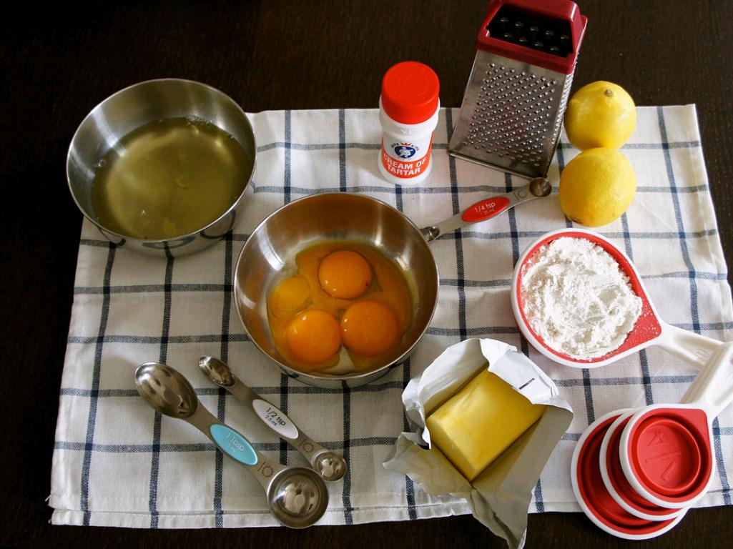
Baking Ingredients
Flour
Liquid
Fat
Leavening Agent
Sugar
Eggs
Spices/Flavorings
cc: Andrea Goh - https://www.flickr.com/photos/47845458@N08

Slide 3
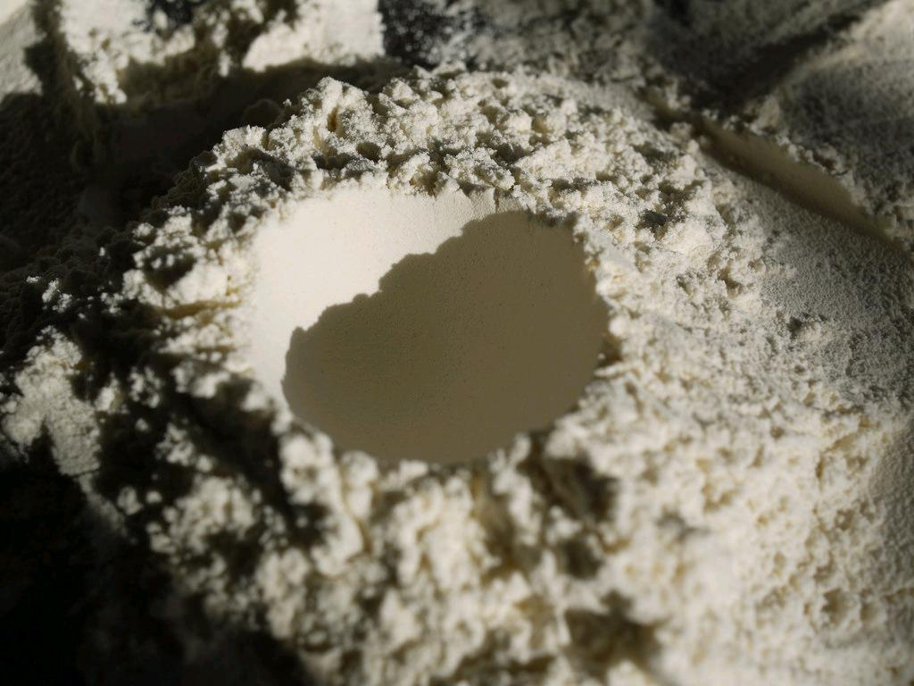
Flour
Used to provide structure in your baked product.
Gluten is the protein found in flour.
When mixed with liquid ingredients, gluten traps air to help in assisting the product rise.
cc: grongar - https://www.flickr.com/photos/70757891@N00

Slide 4

Liquid
Helps to mix and dissolve other ingredients.
Helps to provide moisture to baked goods.
Examples: buttermilk, milk, water, cream, mashed fruit, juice.
cc: r.nial.bradshaw - https://www.flickr.com/photos/33227787@N05

Slide 5
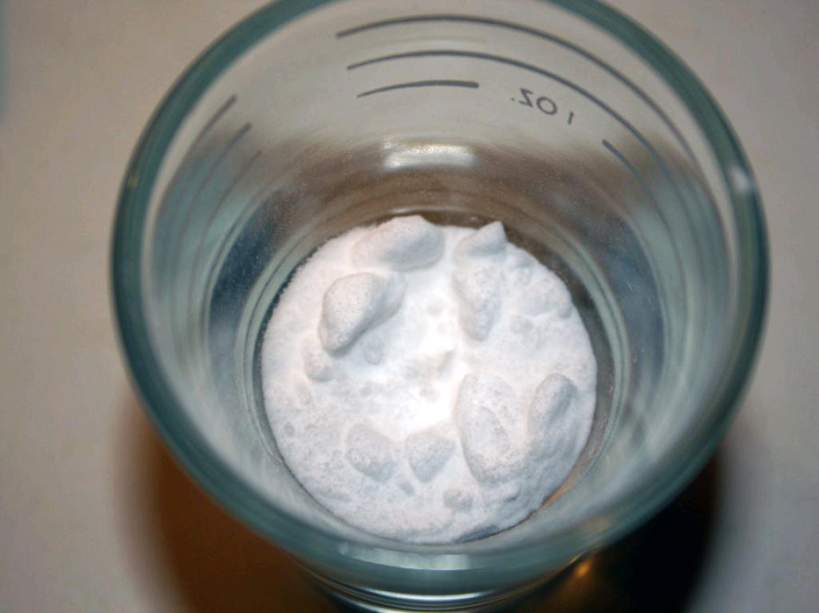
Leavening Agent
Help the product to rise, and have a light texture.
Gases form and cause baked goods to expand.
Examples:
Chemical: baking soda and baking powder
Biological: yeast
Other: eggs, air, steam, cream of tartar.
cc: katalopolis - https://www.flickr.com/photos/31845910@N07

Slide 6
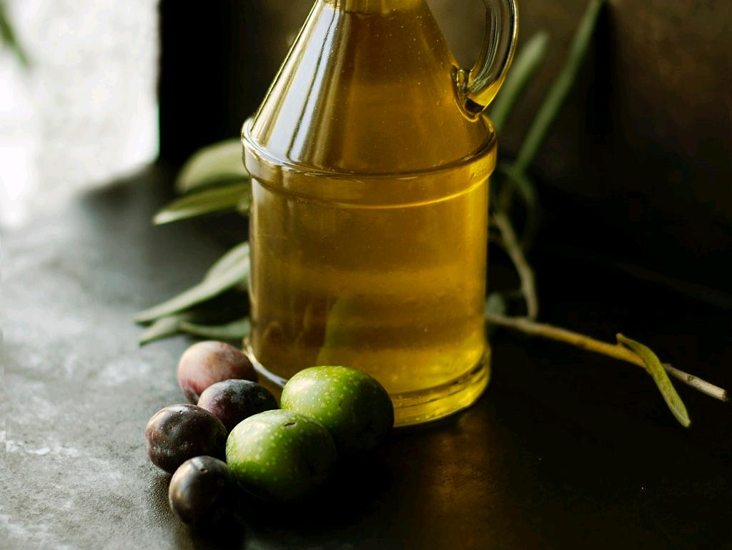
Fat
Types: butter, margarine, oil, shortening.
Function - Helps to provide flavor and tender texture.
Can also help prevent sticking.
cc: Roberta Sorge - https://unsplash.com/@robertina?utm_source=haikudeck&utm_medium=referral&utm_campaign=api-credit

Slide 7
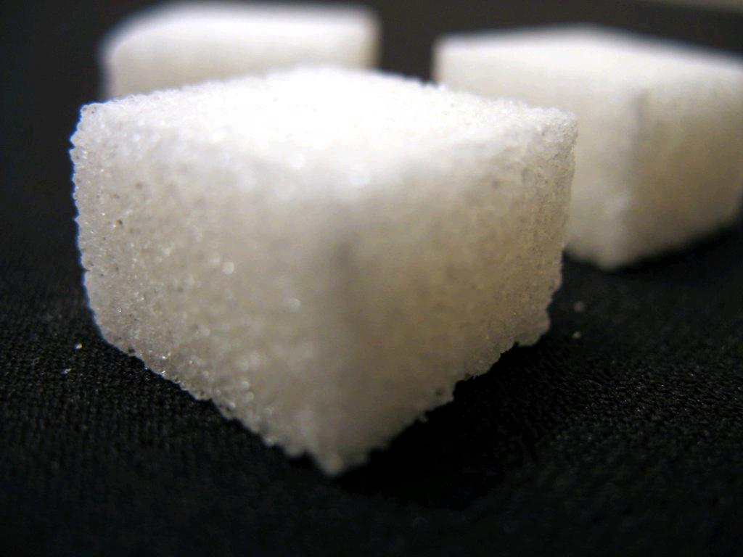
Sugar
Helps to provide sweetness and allows the crust of baked goods to brown.
cc: Uwe Hermann - https://www.flickr.com/photos/73628542@N00

Slide 8
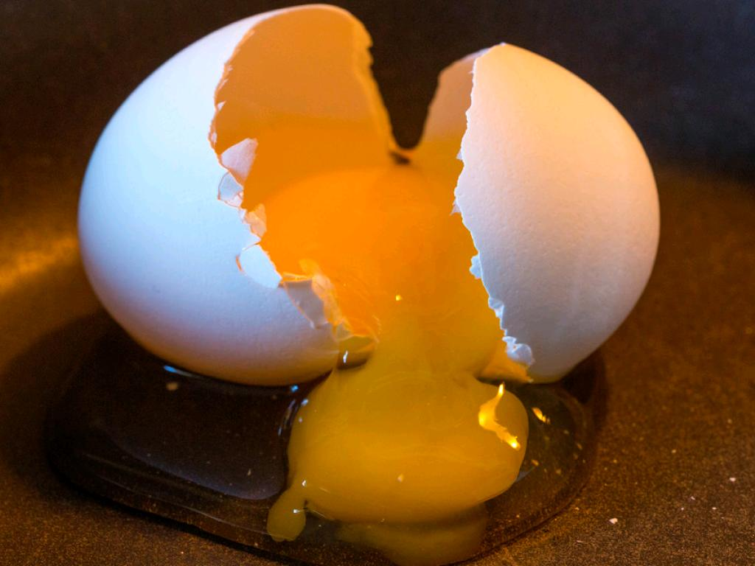
Eggs
Can provide structure and helps to bind ingredients together.
cc: UnknownNet Photography - https://www.flickr.com/photos/110548908@N06

Slide 9
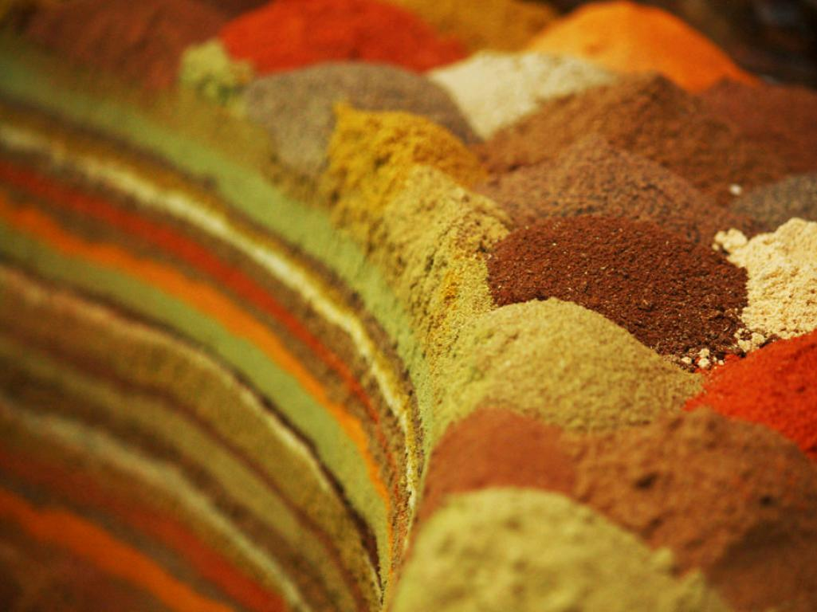
Flavorings
Extracts or spices help to add flavor to baked goods.
Examples: cinnamon, vanilla, nuts, citrus zest.
cc: riy - https://www.flickr.com/photos/7521603@N04

Slide 10
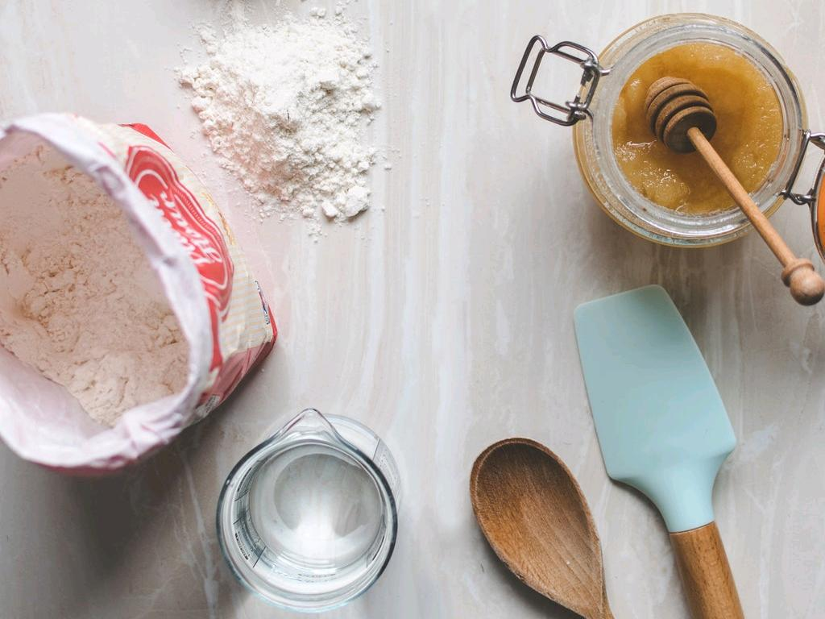
Baking is about accuracy in measuring ingredients. Most commercial baking requires scaling ingredients rather than using graduated measuring cups and spoons.
cc: Calum Lewis - https://unsplash.com/@calumlewis?utm_source=haikudeck&utm_medium=referral&utm_campaign=api-credit

Slide 11

Remember
Level off dry ingredients.
Sift flour and then measure.
When using a scale, don't forget to zero it out.
When using a liquid measuring cup, put on flat surface and get at eye level.
cc: Brooke Lark - https://unsplash.com/@brookelark?utm_source=haikudeck&utm_medium=referral&utm_campaign=api-credit

Slide 12
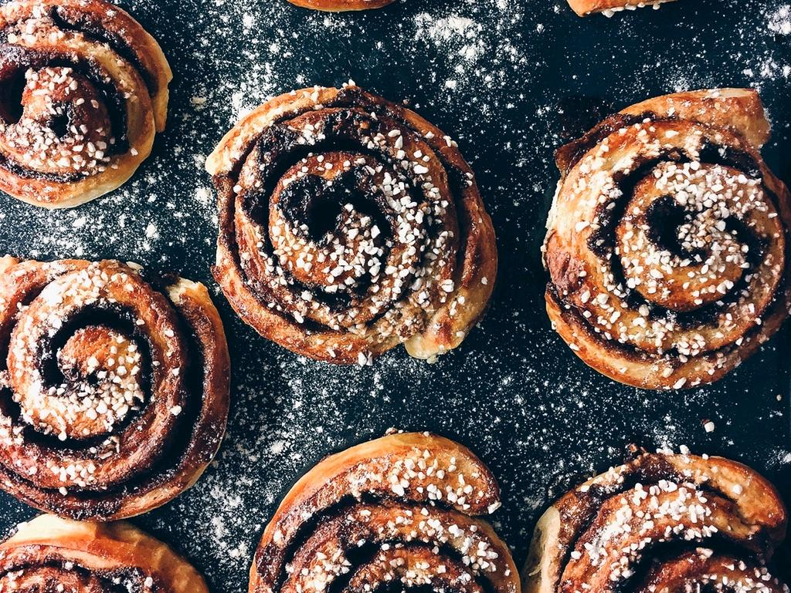
Following a recipe is crucial, especially when it comes to baked goods.
What do you think would happen if one recipe ingredient was measured wrong or even forgotten?
cc: Otto Norin - https://unsplash.com/@otto_norin?utm_source=haikudeck&utm_medium=referral&utm_campaign=api-credit

Slide 13
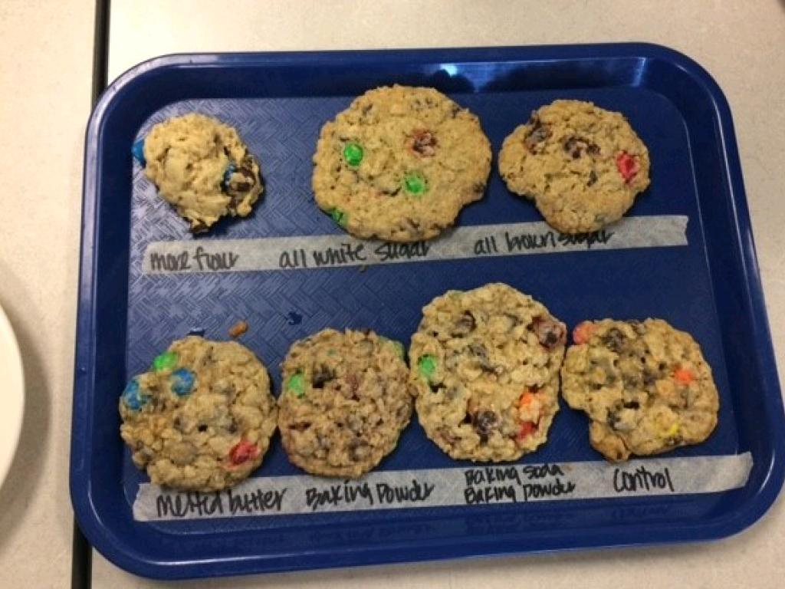
Product Example

