Slide 1
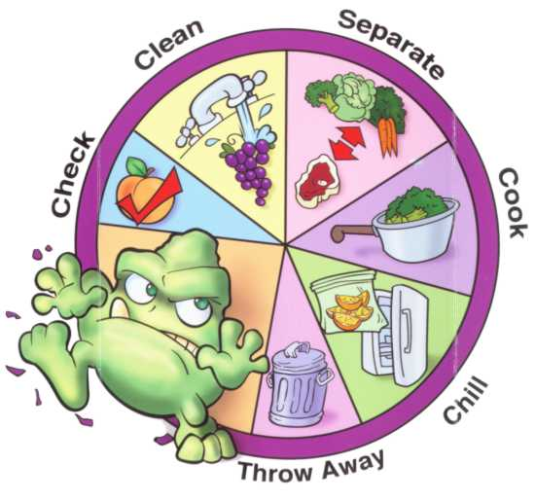
Safe Food Handling

Slide 2
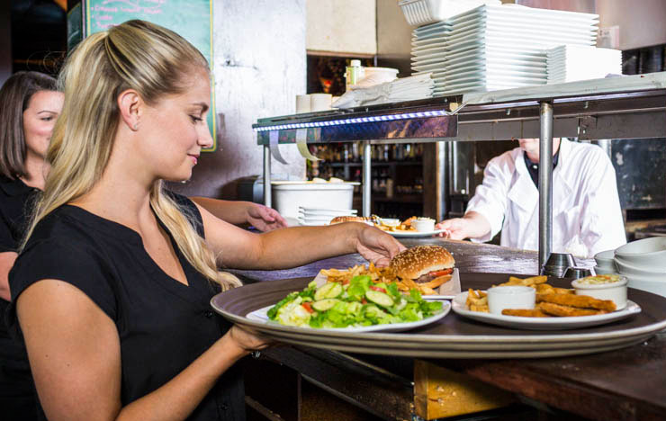
Why Are We Still Getting Sick?!
Lifestyle of convenience and speed
Improper food handling practices
People eat out more
Not enough education is given for prevention

Slide 3


What is Food Borne Illness?
Commonly referred to “food poisoning”
Any illness resulting from food spoilage of pathogenic bacteria, contamination among food, viruses, parasites, or toxins.
What is the difference between food poisoning and a stomach bug?
Notes:
Food poisoning virus/ symptoms are affected a couple of hours after exposure. Stomach virus tends to show up within 1-3 days.

Slide 4
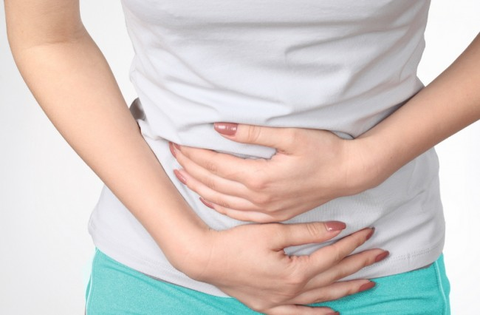
Symptoms:
Chills
Dizziness
Fatigue
Double Vision
Diarrhea
Headaches
Vomiting
    Nausea
    Cramps
Notes:
Symptoms are consistent with the stomach flu. You may need to be hospitalized if symptoms increase!

Slide 5




Who’s At Risk?
Notes:
Elderly, immune system compromised, infants/children, pregnant women. You as a teenager may not fit into this group, but you are still at risk (just not a high risk)

Slide 6
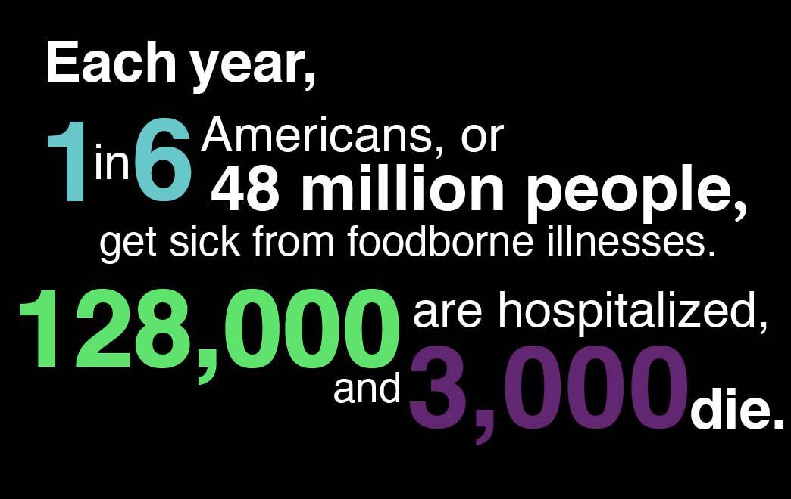
Notes:
There are food safety recalls also happening every day. Not only do people get sick from food poisoning, but companies and farmers lose a lot of money annually from this!

Slide 7

E. Coli
Notes:
Children are more likely to gain the symptoms of E.Coli. These include severe stomach cramps, diarrhea, nausea, and vomiting. Some people are infected but may not exhibit the symptoms.
Symptoms usually end within a week, but some can lead to long-term disability or death.
This strand will live in the digestive tract of humans and animals. Some strands are found in water. There are different types of E.Coli bacterium strands, some are harmless while others are deadly.

Slide 8
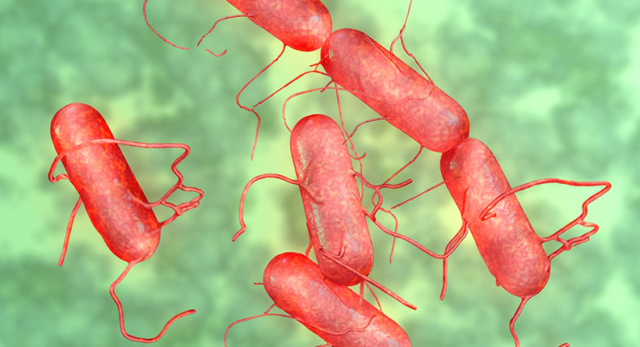
Salmonella
Notes:
This is commonly found in contaminated poultry and eggs. The illness will last from 4-7 days. Symptoms include diarrhea, fever, cramps, and vomiting. You can prevent getting this type of bacteria by avoiding high risk foods. Do not eat undercooked or raw eggs. Cook poultry to the proper internal temperature.

Slide 9
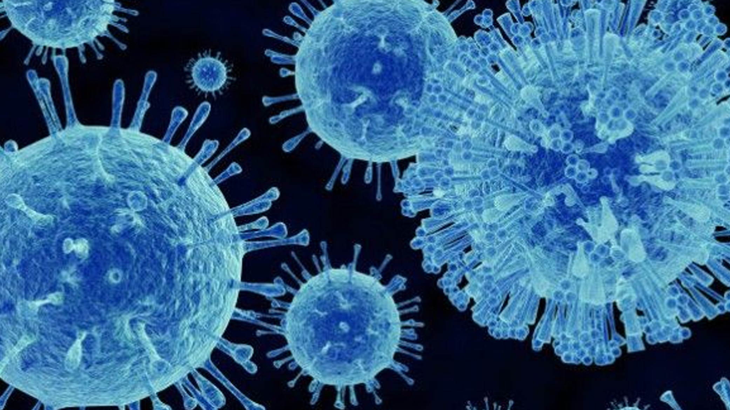
Norovirus
Notes:
Sources include produce, shellfish, and ready to eat foods contaminated by those infected. This is the most common source of stomach infections. It can spread very easily. Symptoms include watery diarrhea and vomiting.
Duration will be 1-3 days unless hospitalized.
Make sure to wash your hands properly and frequently.
Clean and disinfect all surfaces and wear gloves if you work within food service industry.
Wash fruits and vegetables!

Slide 10

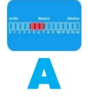




Bacteria Growth
ServSafe 2016
Notes:
The requirements for bacteria growth include food, acid/base conditions, temperature, time, oxygen, and moisture. If all of these environments are present, rapid multiplication of bacteria will occur.

Slide 11

Proper Hand washing
Notes:
Wet your hands with running water — either warm or cold.
Apply liquid, bar or powder soap.
Lather well.
Rub your hands vigorously for at least 20 seconds. ...
Rinse well.
Dry your hands with a clean or disposable towel or air dryer.
If possible, use a towel or your elbow to turn off the faucet.

Slide 12

Proper Dishwashing
Two Compartment Sinks
*Fill up ½ way with water.
*Place 6 Sanitizer Tabs in.
*Agitate water to dissolve.
*Make sure flat side is up on plug.
*Fill ½ way with HOT water.
*Use ONE pump of Dawn Soap.
Notes:
This is how we set up our sinks in our foods labs.

Slide 13
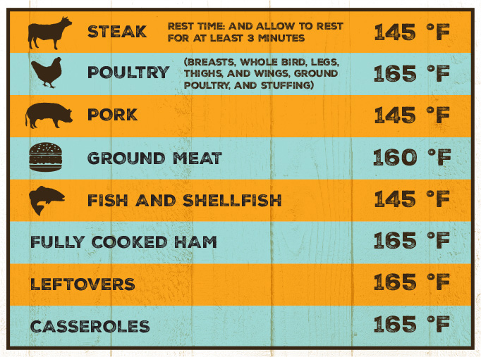
Notes:
Note the different temperatures for whole birds versus the temperature of ground meat? Why the difference?

Slide 14
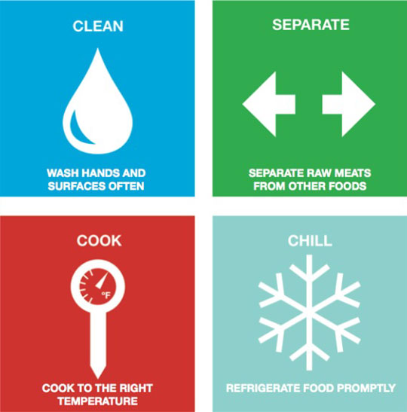
4 Steps to Food Safety
Notes:
Clean, Separate, Cook, Chill are the four steps to food safety. See and go over infographic. (Print one per student from CDC website)

